Slide 1
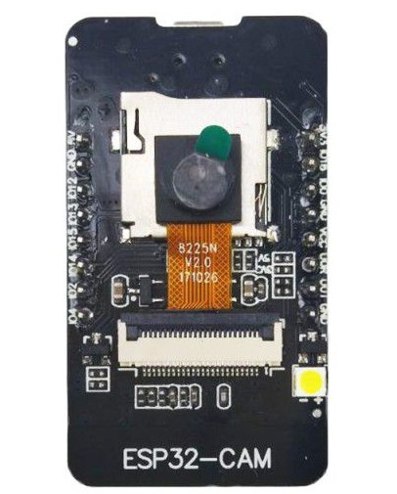
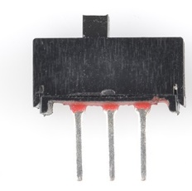
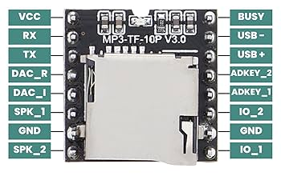
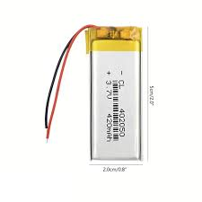
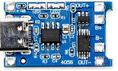

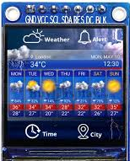
ESP32-Camera
3v3
ON/OFF Switch
GND
IO 16
IO 12
IO 13
IO 15
IO 14
IO 2
IO 4
TP 4056
Li-ion Battery
MP3-TF-TP16
Speaker
1.3 inch Display

